Slide 1
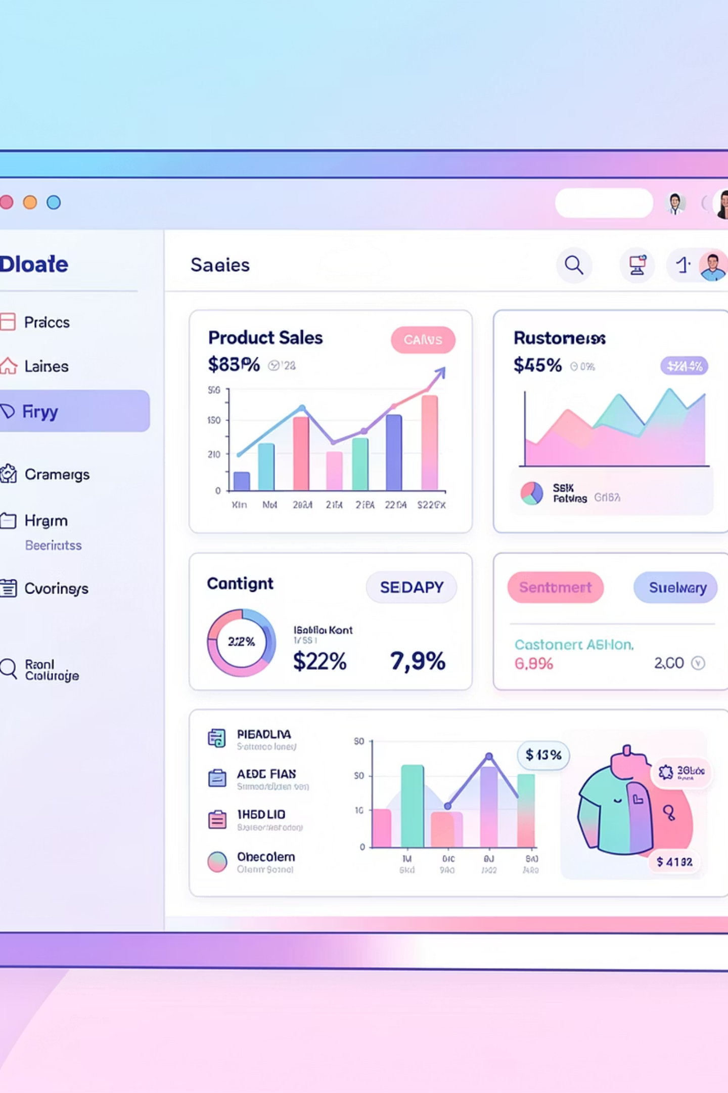
Amazon Product Sales & Sentiment Analysis
Transforming e-commerce data into actionable business intelligence to identify key drivers of customer satisfaction and pricing strategies.

Slide 2

Project Overview
This project analyzes Amazon product performance across categories, focusing on the relationship between discounts, ratings, and popularity. We leverage Python, SQL, and Power BI to deliver insights.
Performance Analysis
Customer Satisfaction
Pricing Strategies
Identify key drivers of product success.
Understand factors influencing positive feedback.
Examine the impact of discounts on popularity.

Slide 3
Dataset Summary
Our dataset details Amazon products, capturing essential attributes for comprehensive analysis.
Product Identification
Categorization
product_id, product_name
category, main_category, product_type
Pricing Metrics
Customer Feedback
actual_price, discounted_price, discount_percentage
rating, rating_count (proxy for sales)

Slide 4
Exploratory Data Analysis (Python)
Initial data processing in Jupyter Notebook for cleaning and preparation.
1
Data Cleaning
Handled missing values and corrected data types for consistency.
2
Data Type Correction
Converted pricing and rating columns to numeric formats, handling special characters.
3
Categorical Mapping
Extracted main_category and product_type for simplified analysis.
4
Discount Tiers
Binned products into "High," "Medium," and "Low" discount brackets.
5
Database Ingestion
Migrated refined data into a relational database using SQLAlchemy and PyMySQL.

Slide 5
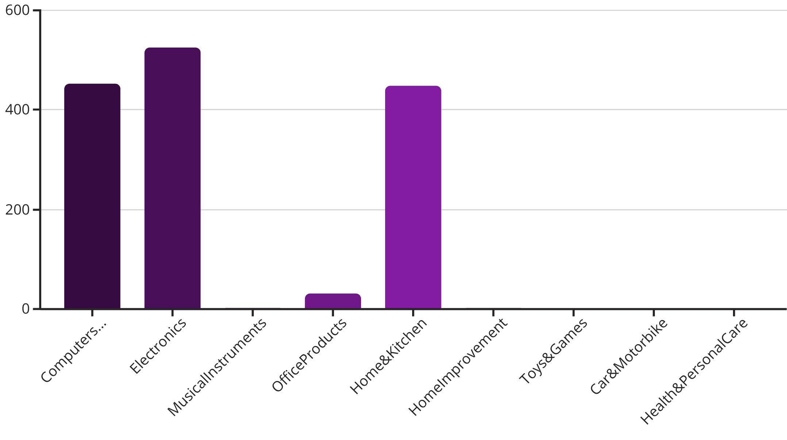
Data Analysis using SQL: Inventory Distribution
Complex SQL queries extracted specific business insights, starting with product counts per category.
The bar chart illustrates the distribution of products across various main categories. Electronics and Computers & Accessories are the most stocked departments, indicating a strong focus on these areas.
This analysis helps identify inventory concentrations and potential areas for expansion or optimization.

Slide 6

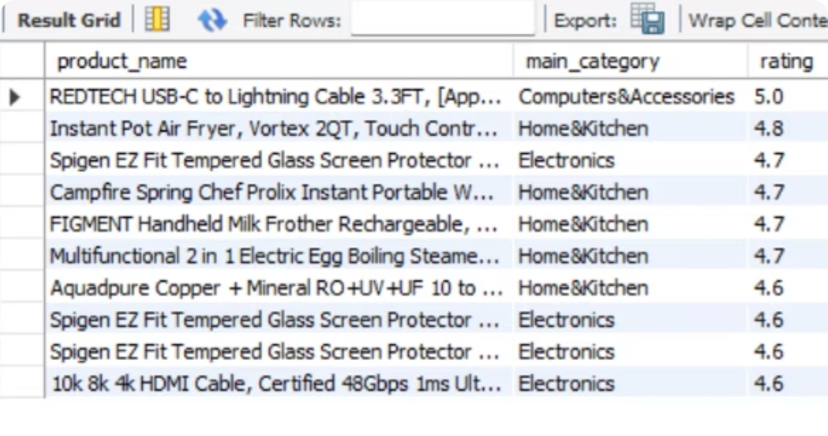
Data Analysis using SQL: High-Value Identification
We identified "Best Value" products: those with a rating above 4.0 and a discount greater than 50%.
REDTECH USB-C to Lightning Cable: 5.0 rating, 75% discount.
Instant Pot Air Fryer: 4.8 rating, 75% discount.
Spigen EZ Fit Tempered Glass: 4.7 rating, 66% discount.
Campfire Spring Chef Prolix: 4.7 rating, 57% discount.
FIGMENT Handheld Milk Frother: 4.7 rating, 56% discount.

Slide 7
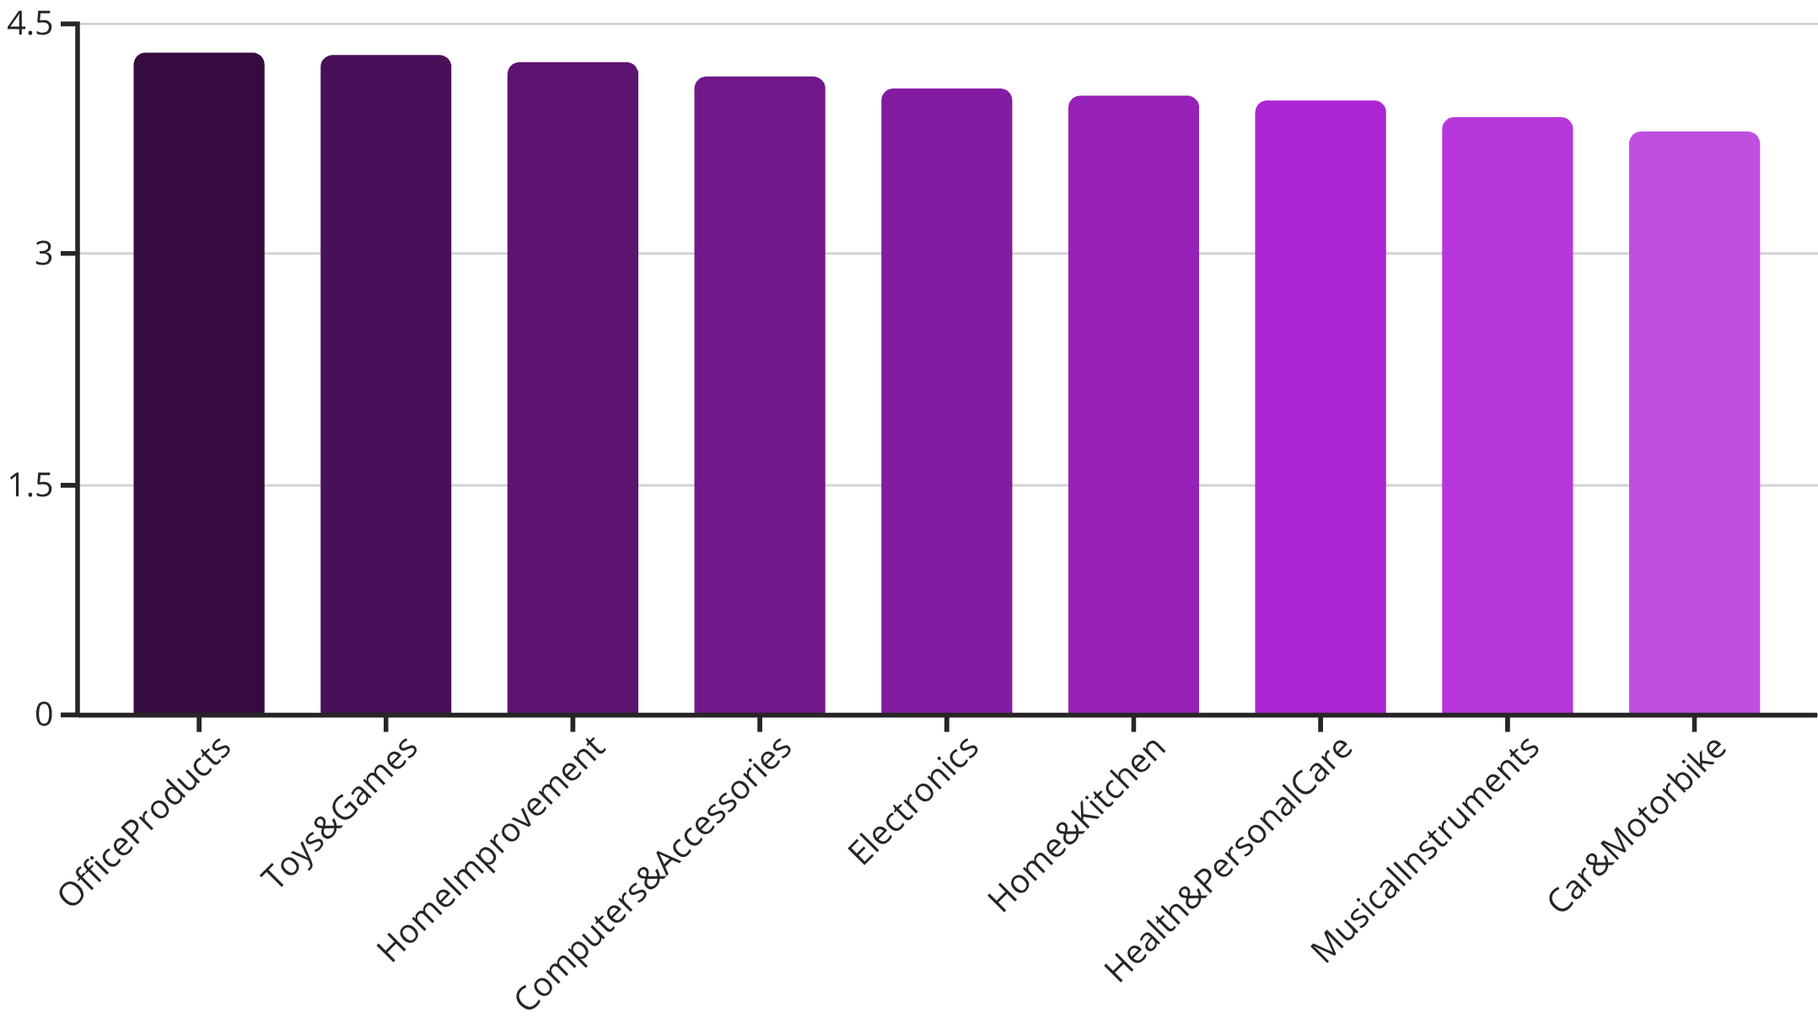
Data Analysis using SQL: Performance Benchmarking
Categories ranked by average customer rating reveal insights into customer satisfaction.
Office Products and Toys & Games lead with the highest average ratings, indicating strong customer satisfaction in these areas.
This ranking helps pinpoint categories excelling in customer experience and those that may require improvement.

Slide 8

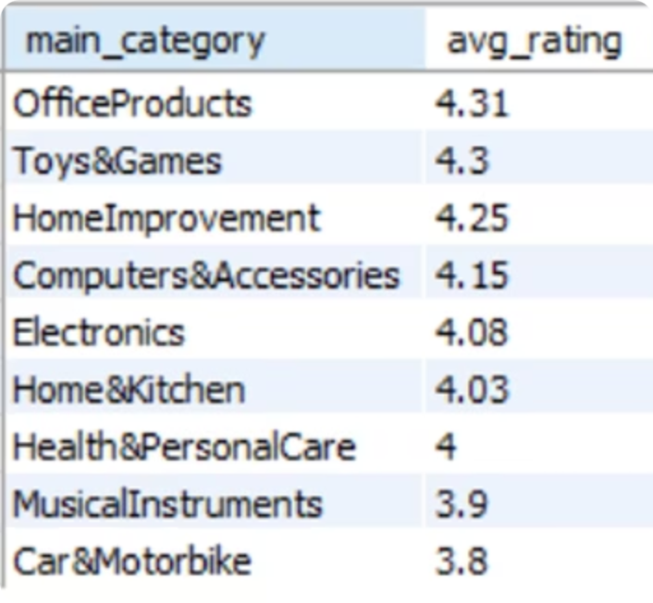
Data Analysis using SQL: Engagement & Discount Distribution
Aggregated rating counts show consumer interaction, while discount percentages highlight pricing strategies.
Total Reviews by Main Category
Average Discount by Main Category
Electronics: 15.7M
Computers&Accessories: 7.7M
Home&Kitchen: 2.9M
OfficeProducts: 149K
MusicalInstruments: 88K
HomeImprovement: 57.5%
Computers&Accessories: 54.02%
Health&PersonalCare: 53%
Electronics: 50.83%
MusicalInstruments: 46%

Slide 9
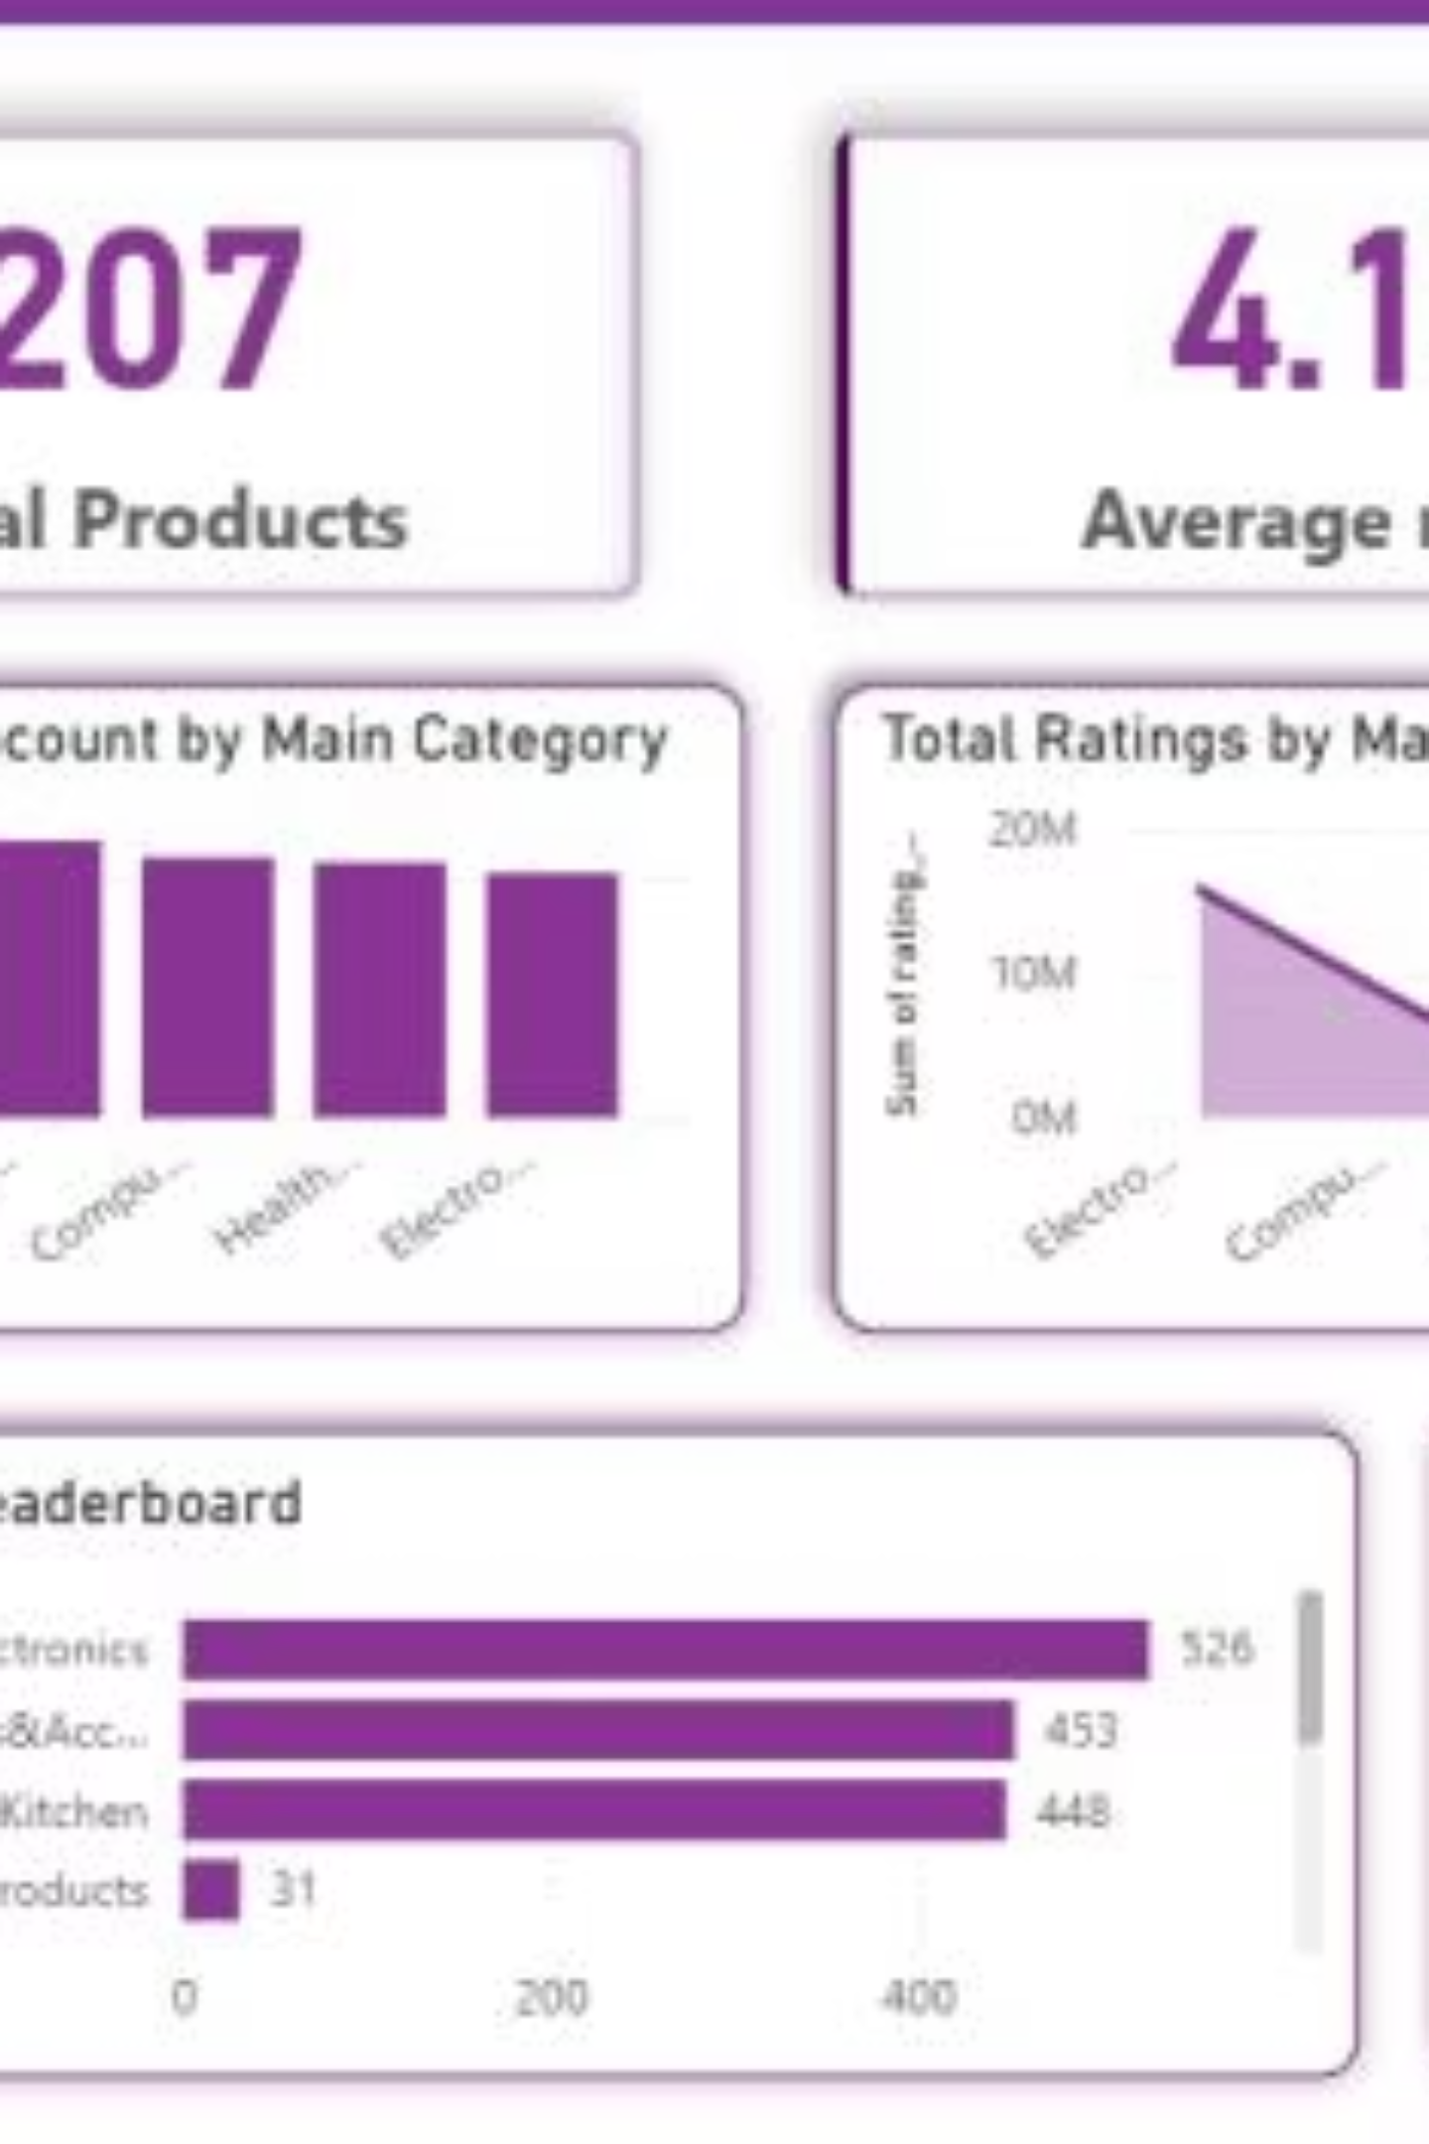
Power BI Dashboard: Key Metrics
207
4.10
47.7%
Total Products
Average Rating
Average Discount

Slide 10
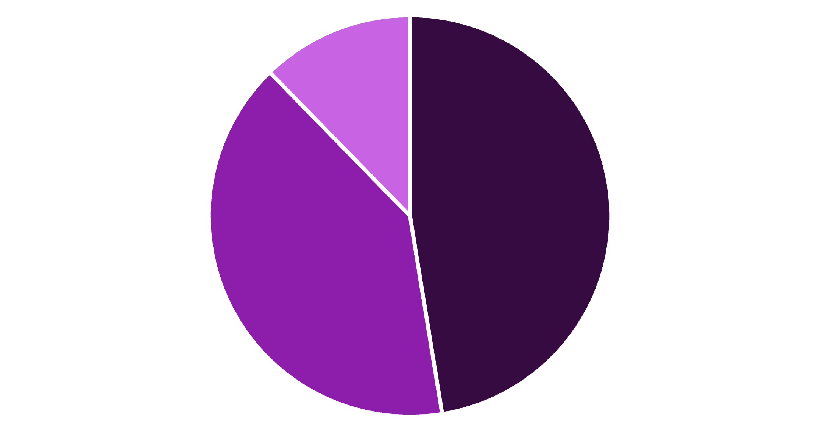
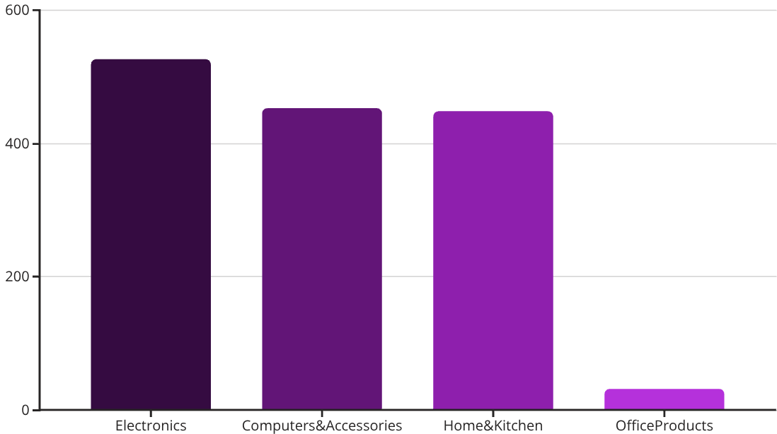
Power BI Dashboard: Discount & Category Insights
The Category Leaderboard highlights Electronics and Computers & Accessories as dominant product categories.
High
Medium
Low
Discount Level Distribution shows nearly half of products are in the "High" discount bracket.

